Slide 1

Lally Building , BMC Chowk, Jalandhar
94637-02116, 19, 24

Slide 2


Slide 3
AI
The Hierarchy
ML
DATA SCIENCE
DEEP LEARNING
DATA ANALYSIS
PYTHON

Slide 4

John McCarthy, a professor emeritus of computer science at Stanford, the man who coined the term "artificial intelligence" and subsequently went on to define the field for more than five decades, died suddenly at his home in Stanford in the early morning Monday, Oct. 25-Oct-2011
Place of birth: Boston
Profession: Professor

Slide 5
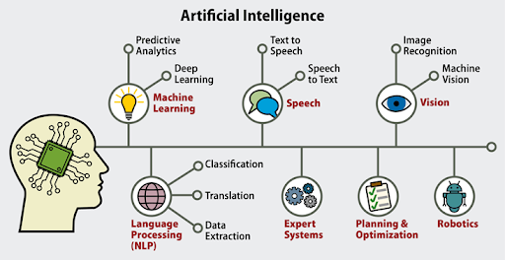

Slide 6

What is Artificial Intelligence (AI)?
AI is a computer system that can perform tasks that normally require human intelligence. It includes recognizing objects, understanding natural language, and making decisions. It is a powerful tool that helps your business grow and improve in many ways.

Slide 7
Examples of AI-Artificial Intelligence
Google Maps and Ride-Hailing Applications
Face Detection and recognition
Text Editors and Autocorrect
Chatbots
E-Payments
Search and Recommendation algorithms
Digital Assistant
Social media
Healthcare
Gaming
Online Ads-Network
Banking and Finance
Smart Home devices
Security and Surveillance
Smart Keyboard App
Smart Speaker
E-Commerce
Smart Email Apps
Music and Media Streaming Service
Space Exploration

Slide 8

Examples of AI-Artificial Intelligence
The Sophia Robot, first shown in 2015 by Hanson Robotics. Courtesy of Hanson Robotics.
Sophia is created to have a human-sized look with a genuine human-like expressive face, patented artificial skin, and configurable skin tone, facial design, language, and arm colors. The artificial intelligence robot has a life-like expressive face that can mimic human emotional expressions
David Hanson
David Hanson (robotics designer)
David Hanson
Born | David Hanson Jr. December 20, 1969 Dallas, Texas
Alma mater | Rhode Island School of Design University of Texas at Dallas
Occupation | Robotics designer
Known for | Creator of Sophia

Slide 9
Specifications
Height | 167 cm | 65.7 in
Width | 41 cm | 16 in
Weight | 20 kg | 45 lb
Sensors
Camera | Intel RealSense camera
 | Chest: Custom wide-angle 1080p
 | Eyes: Two custom 720p HD cameras each
Microphone | External USB microphone
Arm | Arm joints: joint angle sensors and force sensors
 | Fingers: Touch sensors

Slide 10
Specifications
Other | Audio localization array; Inertial measurement unit (IMU)
Actuators
Head and face | Five Dynamixel XM430 servos and 23 Xpert servos.
Eyes | Two Hitec HS-65MG servos
Neck | Three Dynamixel XM430 servos
Arms and hands | Two Dynamixel MX64 servos, one Dynamixel MX106 servo, four Dynamixel XM430 servos, six Xpert servos, and two MKS servos (per arm/hand)
Power | 110/220-V power supply or 24-V lithium-polymer battery
Computing | 3 GHz Intel i7 with 32 GB RAM, integrated GPU
Software | Ubuntu Linux OS, Ethernet, Wi-Fi
Degrees Of Freedom (Dof) | 83 (Head and neck: 36 DoF; Arm and hand: 15 DoF x 2; Torso: 3 DoF; Mobile base: 14 DoF)
Materials | Frubber (actuated skin), carbon fiber, CNC aluminum, steel, Spectra fiber, Delrin thermoplastic, acrylic, polycarbonate, 3D-printed parts, and other mixed media.

Slide 11

Rashmi was developed by Ranjit Srivastava, a Ranchi-based software engineer, as an Indian version of Sophia, the first humanoid robot. This robot was launched on 1 August 2018, 2 years after the start of its development. Its development started as a hobby when Shrivastava's son challenged him after seeing a movie about robots. Ranjit worked alone, without a technical team or research lab.

Slide 12
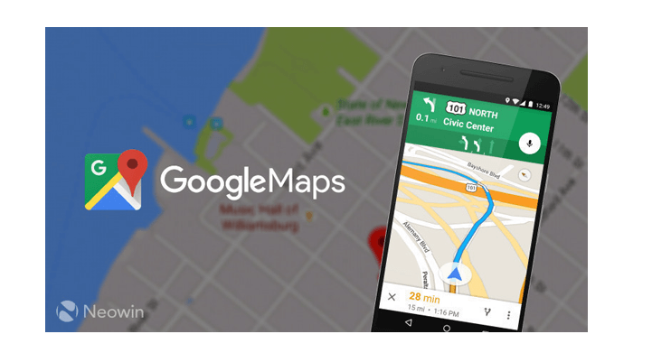
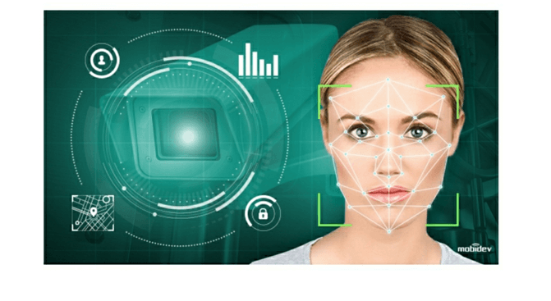




Examples of AI-Artificial Intelligence

Slide 13

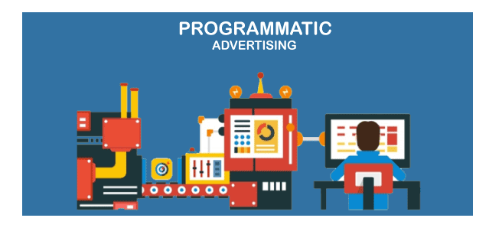

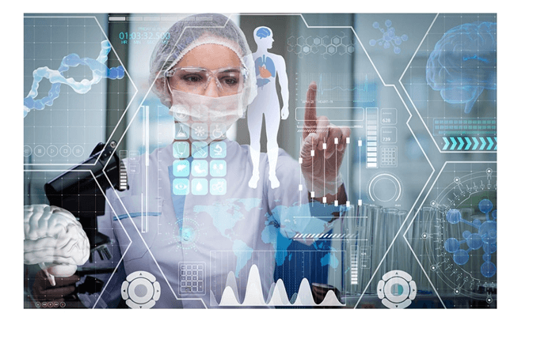

Examples of AI-Artificial Intelligence

Slide 14
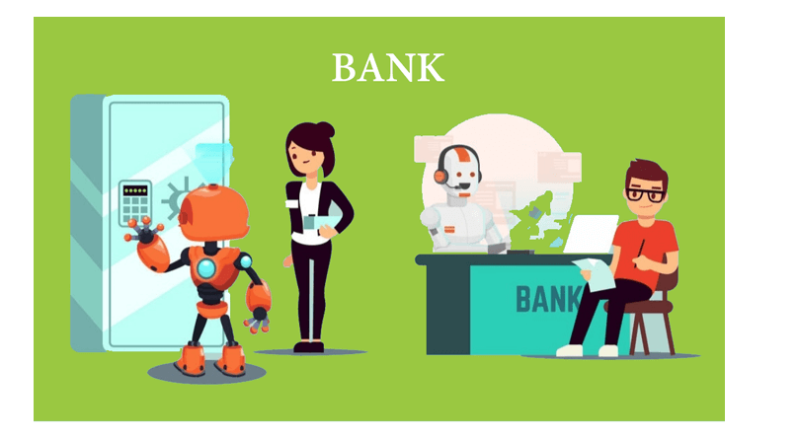



Examples of AI-Artificial Intelligence

Slide 15



Examples of AI-Artificial Intelligence

Slide 16
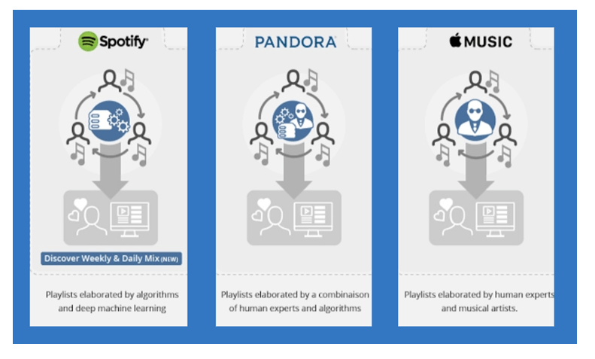
Examples of AI-Artificial Intelligence

Slide 17

Examples of AI-Artificial Intelligence

Slide 18
Goals of Artificial Intelligence
It helps you reduce the amount of time needed to perform specific tasks.
Making it easier for humans to interact with machines.
Facilitating human-computer interaction in a way that is more natural and efficient.
Improving the accuracy and speed of medical diagnoses.
Helping people learn new information more quickly.
Enhancing communication between humans and machines.

Slide 19
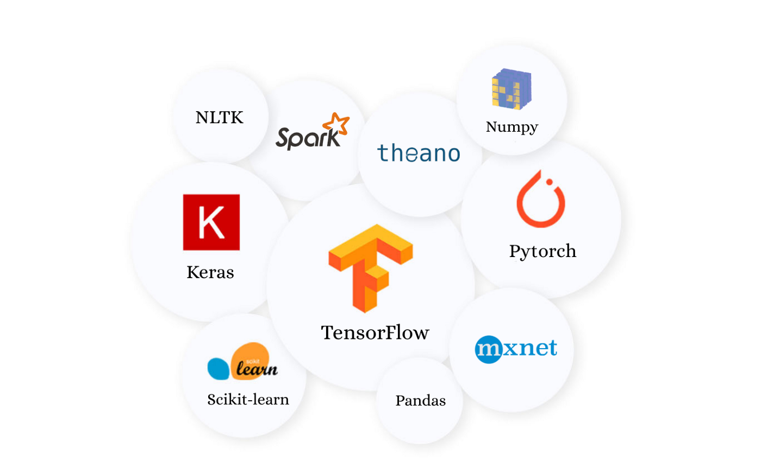
Tools for Machine Learning
& Artificial Intelligence

Slide 20

Real World Examples Machine Learning
1. Image recognition
Image recognition is a well-known and widespread example of machine learning in the real world. It can identify an object as a digital image, based on the intensity of the pixels in black and white images or colour images.
Real-world examples of image recognition:
Label an x-ray as cancerous or not
Assign a name to a photographed face (aka “tagging” on social media)
Recognize handwriting by segmenting a single letter into smaller images
Machine learning is also frequently used for facial recognition
within an image. Using a database of people, the system can
identify commonalities and match them to faces. This is often used in law enforcement.

Slide 21

Real World Examples Machine Learning
2. Speech recognition
Machine learning can translate speech into text. Certain software applications can convert live voice and recorded speech into a text file. The speech can be segmented by intensities on time-frequency bands as well.
Real-world examples of speech recognition:
Voice search
Voice dialing
Appliance control
Some of the most common uses of speech recognition
software are devices like Google Home or Amazon Alexa.
Person : Alexa main theek nahi houn
Alexa: Aap sou jayeeaye koi gal nahi

Slide 22
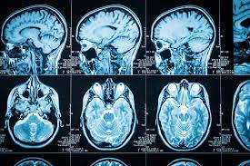
Real World Examples Machine Learning
3. Medical diagnosis
Machine learning can help with the diagnosis of diseases. Many physicians use chatbots with speech recognition capabilities to discern patterns in symptoms.
Real-world examples for medical diagnosis:
Assisting in formulating a diagnosis or recommends a treatment option
Oncology and pathology use machine learning to recognize cancerous tissue
Analyse bodily fluids
In the case of rare diseases, the joint use of facial recognition
software and machine learning helps scan patient photos
and identify phenotypes that correlate with rare genetic
diseases.

Slide 23
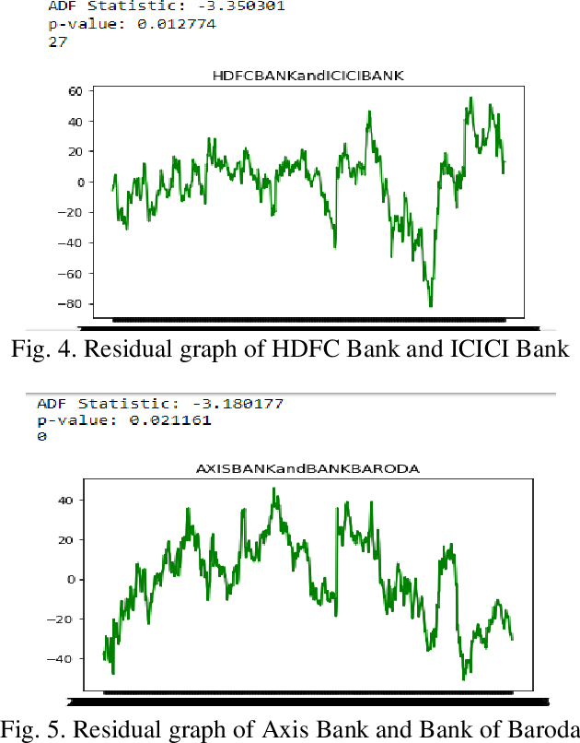
Real World Examples Machine Learning
4. Statistical arbitrage
Arbitrage is an automated trading strategy that’s used in finance to manage a large volume of securities. The strategy uses a trading algorithm to analyse a set of securities using economic variables and correlations.
Real-world examples of statistical arbitrage:
Algorithmic trading which analyses a market microstructure
Analyse large data sets
Identify real-time arbitrage opportunities
Machine learning optimises the arbitrage strategy to enhance results.

Slide 24
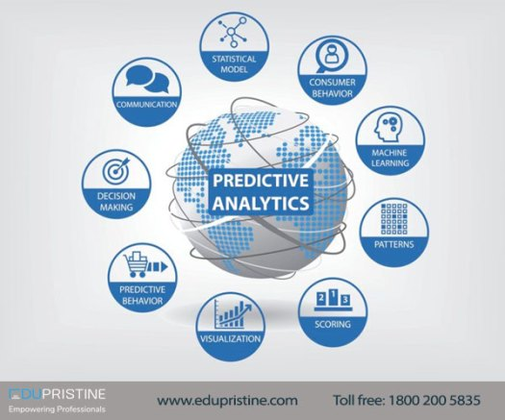
Real World Examples Machine Learning
5. Predictive analytics
Machine learning can classify available data into groups, which are then defined by rules set by analysts. When the classification is complete, the analysts can calculate the probability of a fault.
Real-world examples of predictive analytics:
Predicting whether a transaction is fraudulent or legitimate
Improve prediction systems to calculate the possibility
of fault
Predictive analytics is one of the most promising
examples of machine learning. It's applicable for everything;
from product development to real estate pricing.

Slide 25
Real World Examples Machine Learning
6. Extraction
Machine learning can extract structured information from unstructured data. Organisations amass huge volumes of data from customers. A machine learning algorithm automates the process of annotating datasets for predictive analytics tools.
Real-world examples of extraction:
Generate a model to predict vocal cord disorders
Develop methods to prevent, diagnose, and treat the disorders
Help physicians diagnose and treat problems quickly
Typically, these processes are tedious. But machine
learning can track and extract information to obtain billions of data samples.

Slide 26
Real World Examples Machine Learning
7. Cognitive Issue Resolution (CIR)
Cognitive Issue Resolution uses natural language processing and machine learning models to read, reply, and resolve email queries and issues sent to your company. Using machine learning models to read and reply to customers and employees automatically saves time and labor costs for your customer service, finance, sales, and human resource teams by reading and automatically answering questions and providing a self-service model to customers.
CIR connects with your email, internal apps, data sources, ticketing systems, and other AI to reply to customers and employees. Once connected, intelligent automation platforms like Krista extract attributes from incoming email messages using proprietary machine learning models and natural language processing (NLP). These attributes help determine the next best action and initiate automated workflows based on identified attributes.

Slide 27
Real World Examples Machine Learning
8. Intelligent Document Processing (IDP)
Intelligent Document Processing extracts data from documents using machine learning and NLP. The extracted data or “entities” can then be used to automate tasks such as anomaly detection, data entry, invoice processing, and contract management.
9. Revenue Ops (RevOps)
Revenue Ops is the application of machine learning to sales and marketing data to improve customer acquisition, conversion, and retention. Machine learning can be used to identify trends in customer behavior, predict which prospects are most likely to convert, and recommend the best next action for sales and marketing teams.
10. Cybersecurity Operations
Security orchestration, automation, and response (SOAR) platforms seek to streamline and improve an organization’s security operations. Some common machine learning examples for security operations include incident detection, classification, investigation, and response.

Slide 28
Real World Examples Machine Learning
11. Governance Risk and Compliance (GRC)
GRC platforms provide an integrated suite for managing risk and compliance requirements. They help companies effectively manage their IT security risks and reduce costs while meeting industry regulations like GDPR or PCI-DSS.
12. Contact Center and Omni-Channel Customer Support
Many digital transformation projects seek to either enhance customer experiences or employee experiences. Overhauling the contact center is one of the best transformation projects and machine learning examples.
contact center agent Contact center jobs are more complex than they need to be. Contact centers need to simplify workflows to improve customer and employee experiences. Companies that have grown by acquisition or not properly streamlined the contact center workflow often force too many apps and screens onto contact center employees. Too many apps cause long call times and frustrate both the customer and the employee.

Slide 29
Real World Examples Machine Learning
13. Contact Center – Self-Service Chatbot
Self-service chatbots are a type of artificial intelligence that can interact with humans to perform tasks or answer questions. Businesses use chatbots to provide fast and accurate answers to common questions.
14. Predictive analytics
Whether it’s banking, retail, or manufacturing, predictive analytics helps companies make better decisions.
Predictive analytics is the branch of advanced analytics dealing with predicting future events based on historical data and analytics techniques such as statistical modeling, machine learning, and data mining. Predictive analytics helps to identify trends, make recommendations, and even automate decision-making.

Slide 30
Real World Examples Machine Learning
15. Personalized Customer Recommendations on E-Commerce Stores
E-commerce stores use machine learning to make personalized recommendations to their customers. Machine learning algorithms analyze customer data to understand customer preferences and predict future behavior. This allows ecommerce sites to recommend products that are more likely to be of interest to individual customers.
The largest eCommerce store is Amazon. Amazon uses machine learning to make product recommendations to customers based on their past behavior. Amazon.com also uses machine learning to target ads to individual customers.

Slide 31
Real World Examples Machine Learning
16. Self-Driving Cars and Automated Transportation Systems
Self-driving cars use machine learning to navigate routes and avoid obstacles. Machine learning algorithms map out the environment and identify barriers, people, cyclists, and other hazards. Machine learning trained for computer vision classifies objects and determines their purpose. Doing so allows self-driving or autonomous cars to decide how to navigate their environment best and avoid obstacles.
17. Digital Content Search
One of the first steps in transforming businesses into digital businesses is digitizing content and producing digital documents. As companies digitize the content, they produce thousands or millions of documents stored in various forms. Quickly finding information in these documents increasingly challenges businesses.
Google AI
https://ai.google/

Slide 32
What is Data?
Data is data that's collected through things like seeing things, measuring things, doing research, or analyzing things.
They may be composed of facts, figures, names, numbers, or descriptions of objects. Data is organized in the form of graphs, charts, or tables.
There exist data scientist who does data mining and with the help of that data analyze our world.
E.g. : You recorded the height and weight of every student and tabulated it. This table can be used to obtain data about individual students and it can also be used for other purposes such as the calculation of average height and weight of your class. Moreover, you can find the tallest and the shortest classmate of yours.

Slide 33






What is Messy Data?
It is rare for analysts to start work on a new dataset without first cleaning it. This does not necessarily mean that the dataset is messy, but rather that it does not meet the necessary standards for analysis. An example of a messy dataset is one that contains a standardization that should be corrected; for instance, the word "California" is spelled as "Calif." when it should be "CA". Another example is a dataset that contains dashes in phone numbers when there should not be any additional punctuation.
Beyond standardization, there are many other types of errors that may need to be cleaned in dirty data. These errors can include:
Missing data
Unstructured data
Multiple variables in one column
Variables stored in the wrong places
Observations split incorrectly or left
together against normalization rules
Switched columns and rows
Extra spaces and more…

Slide 34
What is information?
Information is a collection of data that gives everyone an advantage since it helps in decision-making for the individuals involved. Data is the term used to describe information entered into and saved on a computer.
Data that has undergone processing, such as editing and printing, can once again be recognized as information.
Characteristics of information:
Subjectivity: The value and usefulness of information are highly subjective, because what is information for one person may not be for another.
Relevance: Information is good only if it is relevant - that is, pertinent and meaningful to the decision maker.
Timeliness: Information must be delivered at the right time and the right place to the right person.
Accuracy: Information must be free of errors because erroneous information can result in poor decisions and erode the confidence of users.
Correct information format: Information must be in the right format to be useful to the decision-maker.
Completeness: Information is said to be complete if the decision maker can satisfactorily solve the problem at hand using that information.
Accessibility: Information is useless if it is not readily accessible to decision makers, in the desired format, when it is needed.

Slide 35
Anomalies in Dataset
Anomaly Detection (AD) is the process of identifying unusual occurrences or observations that may give rise to suspicion by being statistically distinct from other observations. Such "unusual" behavior is typically indicative of a specific issue, such as a credit card scam, a server failure, or a cyber attack.
An anomaly can be broadly categorized into three categories –
Point Anomaly: A tuple in a dataset is said to be a Point Anomaly if it is far off from the rest of the data.
Contextual Anomaly: An observation is a Contextual Anomaly if it is an anomaly because of the context of the observation.
Collective Anomaly: A set of data instances help in finding an anomaly.
Anomaly detection can be done using the concepts of Machine Learning.

Slide 36
Data Preprocessing Activities
Data processing occurs when data is collected and translated into usable information.
Data processing is usually done by a data scientist or a group of data scientists, and it's important to do it right so it doesn't hurt the final product or data output.
Data processing begins with raw data and translates it into something more legible (like graphs or documents), giving it the structure and context it needs to be understood by computers and used by people all over the company.

Slide 37
Stages of Data Preprocessing
Data collection: The process of data processing begins with the collection of data. Data is extracted from various sources, such as data lakes or data warehouses. Data sources must be reliable and well-structured in order to ensure the quality of the collected data (and its subsequent use as information).
Data preparation: Once you've gathered the data, it's time to move on to the data preparation phase. Data preparation, also known as "pre-processing" is when you clean up and organize your raw data for the next step in data processing. During this step, you make sure your raw data is free of any mistakes. The goal is to get rid of any bad data (unnecessary, incomplete, or wrong data) and start creating the best data for your business intelligence.
Data Input: The clean data is then entered into its destination and translated into a language that it can understand. Data input is the first stage in which raw data begins to take the form of usable information.

Slide 38
Processing: During this phase, the data entered into the computer in the preceding phase is in fact processed for interpretation. The processing is carried out by machine learning algorithms, although the actual process may differ slightly depending on the data source (data lake, social network, connected device, etc.) and the purpose of the data (analyzing advertising patterns, diagnosing medical conditions from connected devices, identifying customer needs, etc.).
Data output/interpretation: Output/interpretation is the point at which the data is finally available to people who aren’t data scientists. It’s translated, it’s legible, and it’s often presented in visual form (graphs, videos, pictures, plain language, etc.). Employees of the business or institution can start using the data on their own projects for data analytics.
Data storage: Storage is the last stage of data processing. After all data has been processed, it is stored for the future. While some of the information may be used immediately, most of it will be stored for later use. Furthermore, proper storage of data is essential for adhering to data protection legislation such as the General Data Protection Regulation (GDPR). When data is stored correctly, it can be accessed by the members of the organization in a timely manner.

Slide 39


Data Analysis

Slide 40

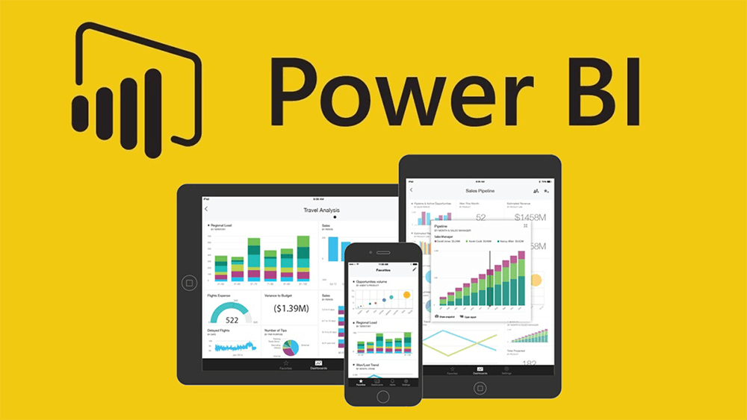

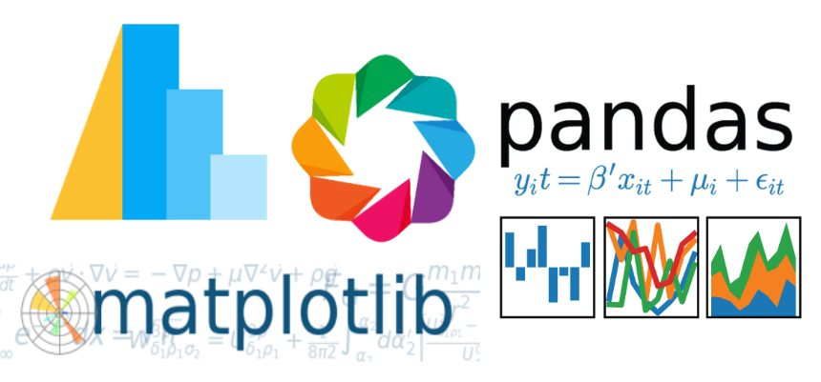


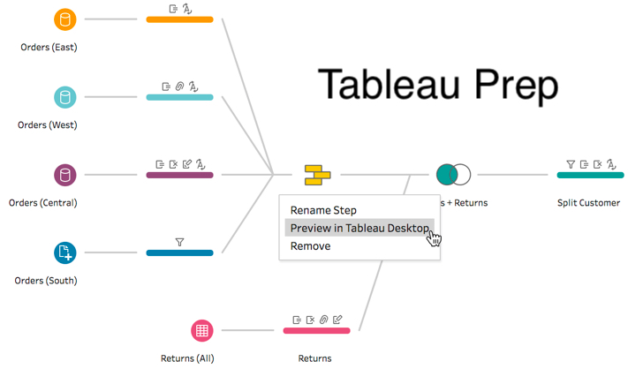



Tools for Data Analysis and
Data Science

Slide 41
What is Data Analysis?
Data analysis is a field of study that involves the analysis of data in order to make inferences or gain insight into different topics.
It involves exposing data to operations. The purpose of this process is to generate accurate results to help us reach our objectives, including operations that cannot be defined in advance as data collection may uncover particular challenges.
Data analytics enables businesses to gain a better understanding of their target market, generate more sales, reduce expenses, generate more revenue, and enable more effective problem-solving. Data analysis plays a vital role in a variety of areas of contemporary businesses and organizations.
“A lot of data analysis will help humans work smarter and faster because we have data on everything that happens.” –Daniel Burrus

Slide 42
Need for Data Analysis
Customer digital footprints offer valuable insights into preferences, needs, and online behavior. Analyzing this data helps companies identify trends and tailor products/services accordingly, boosting loyalty and sales. Neglecting these insights risks losing customers to more attentive competitors.
Data analytics enables informed, efficient business choices, preventing wasteful spending on ineffective strategies, operations, marketing, or untested ideas. Adopting data-driven decisions empowers proactive opportunity identification based on valid data instead of intuition. Yet, decision-makers must acknowledge the potential for inaccuracies if analysis or collection processes are flawed.
Data informs strategies and targeted marketing for engaging promotions. Analysis of trends, online shopping, and transactions enables customized advertising to reach evolving consumer segments, enhancing marketing efficiency. Insights into consumer behavior drive customer-oriented marketing, exceeding expectations, fostering loyalty, and driving growth.
Data analytics enhances operational efficiency by extracting insights from customer data and feedback. Patterns deduced aid in product and service optimization while identifying chances for cost reduction and profit maximization. Analytics guides informed decisions to adjust strategies, tackle problems, manage risks, and drive improvements, fostering proactive operations.
Data analytics aids innovation by understanding the audience, spotting gaps, and creating offerings. Real-time tracking of feedback and rivals enables competitiveness. Insights drive updates, adaptable products, marketing tweaks, and improved customer services, crucial for business success.

Slide 43
Data Science

Slide 44
What is Data Science?
Data Science combines mathematics, statistics, programming, analytics, artificial intelligence (AI), and machine learning which encapsulates the potential to uncover actionable decisions and hidden data in any organization.
It is an emerging field that sees its importance grow with each passing day.
Nowadays, organizations are overwhelmed with data. Data Science will help in extracting meaningful insights from that by combining various methods, technology, and tools
Companies such as Google, Amazon, Microsoft, and Apple have been among the biggest recruiters of Data Scientists.

Slide 45
Why Data Science?
A company almost can’t survive today without adopting a data-driven approach to their business and advancing it based on trending applications. Yet, the supply of data scientists still remains quite low, hence the demand.
Without the expertise of professionals who turn cutting-edge technology into actionable insights, Big Data is nothing.
In the past few years, the demand for data science skills and data-driven decision-making has steeply risen as they become essential tools for organizations that want to do everything they can to ensure success.

Slide 46
Data Science applications and examples
Healthcare: Data science can identify and predict disease, and personalize healthcare recommendations.
Transportation: Data science can optimize shipping routes in real time.
Sports: Data science can accurately evaluate athletes’ performance.
Government: Data science can prevent tax evasion and predict incarceration rates.
E-commerce: Data science can automate digital ad placement.
Gaming: Data science can improve online gaming experiences.
Social media: Data science can create algorithms to pinpoint compatible partners.
Fintech: Data science can help create credit reports and financial profiles, run accelerated underwriting, and create predictive models based on historical payroll data.

Slide 47
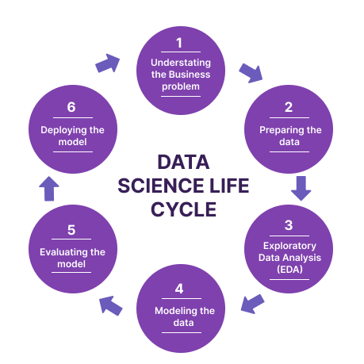

Slide 48
Data Science Life Cycle
1. Business Understanding: The entire cycle centers around the enterprise objective. What will you solve if you no longer have a particular issue? It is extremely important to genuinely understand the commercial enterprise goal, as this will be your primary objective of the analysis. Following desirable perception, only we can determine the exact objective of evaluation that aligns with the enterprise goal. For example, you must determine if the customer wishes to reduce the amount of savings lost, or if they would prefer to forecast the price of a commodity.
2. Data Understanding: Following enterprise understanding, the next step is data understanding, which encompasses a collection of all the available data. Here, it is essential to collaborate closely with the commercial enterprise team, as they are likely aware of the information available, which facts should be employed for this commercial enterprise issue and other information. This step involves describing the data, structure, relevance, and record type. Graphical plots are used to explore the information. In other words, extracting any information that can be derived from the data by simply examining it.

Slide 49
3. Preparation of Data: The next step is data preparation. This includes the selection of relevant data, integration of the data sets by combining them, cleaning of the data, treatment of missing values by either elimination or imputation, treatment of inaccurate data by elimination, testing for outliers by using box plots, and dealing with them. Creating new data, and extracting new elements from existing data. Formatting the data according to the desired structure, removing any unwanted columns and characteristics. Data preparation may be the most labor-intensive but is arguably the most important step in the entire existence cycle. The accuracy of your model will depend on the accuracy of your data.
4. Exploratory Data Analysis: This step includes getting some concept about the answer and elements affecting it, earlier than constructing the real model. The distribution of data inside distinctive variables of a character is explored graphically with the usage of bar graphs, Relations between distinct aspects are captured via graphical representations like scatter plots and warmth maps. Many data visualization strategies are used to discover each and every characteristic individually and by means of combining them with different features.

Slide 50
5. Data Modelling: At the core of data analysis lies data modeling. A model receives the structured data as input and outputs the desired outcome. This step involves selecting the appropriate type of model, such as a classification problem, a regression problem, or a cluster problem. After selecting the model family and the number of algorithms within that family, we must carefully select the algorithms to implement and enforce. We must adjust the hyperparameters for each model to achieve the desired performance. Additionally, we must ensure that there is an appropriate balance between overall performance and overall applicability. We no longer want the model to analyze the data and perform poorly on new data.
6. Model Evaluation: This is where the model is evaluated to determine if it is ready for deployment. The model is tested on unseen data and evaluated on a carefully considered set of assessment parameters. Furthermore, it is necessary to ensure that the model is in line with reality. If a quality final result is not achieved in the evaluation, the entire modeling process must be repeated until the desired stage of metrics is reached. Every data science solution, machine learning model, is, like a human, constantly evolving, and must be able to improve itself with new data and adapt to a new assessment metric. While it is possible to construct multiple models for a particular phenomenon, many of them may be imperfect. Model assessment assists in selecting and constructing an ideal model.

Slide 51
7. Model Deployment: The model is then deployed in the desired structure and channel after a thorough evaluation. This is the final stage of the data science lifecycle. Every step of the life cycle outlined above must be carefully considered; if any step is performed incorrectly, it will have an impact on the next step and the entire effort will be wasted. For instance, if data is not aggregated correctly, records will be lost and the ideal model will no longer be built. If data is not cleaned correctly, the model will cease to function. If a model is not evaluated correctly, it will not be successful in the real world. From Business Perception to model deployment, each step must be given due consideration, time, and energy.

Slide 52
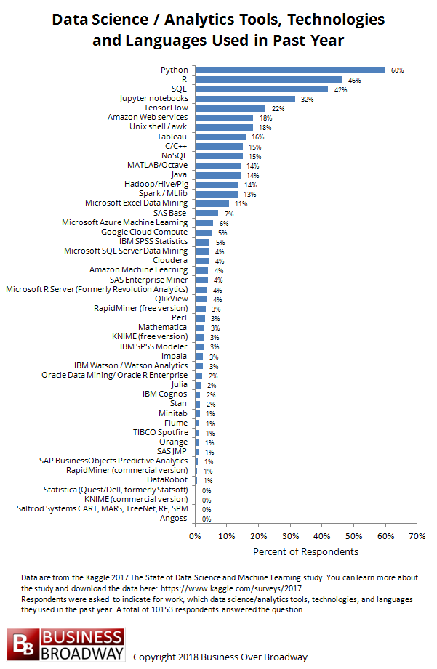
Most Popular Data analytics/Science tools:
Python
R
SQL
Jupyter notebooks
TensorFlow
C/C++
NoSQL
MATLAB/Octave
Java
Hadoop/Hive/Pig
Spark/Mlib
Microsoft Excel Data Mining and more…
Data from Kaggle about the most used data science/analytics tools, technology, and languages. Responded by over 10,000 respondents.

Slide 53
Data Exploration
Data exploration techniques encompass both manual data analysis and automated data analysis software solutions that analyze and visualize data variables, dataset structure, outliers, and data value distribution to uncover correlations and observation points, allowing data analysts to gain a deeper understanding of the raw data.
Data is often collected in voluminous, unstructured formats from multiple sources and data analysts need to understand and create a holistic view of the data prior to extracting pertinent data for analysis, including univariate data, bivariate data, multivariate data, and principal component analysis (PCA).
Some tools for data exploration are Google Looker, Google Fusion Tables, Tableau, Microsoft Power BI, and more…

Slide 54
Data Preparation
The process of data preparation involves the collection, cleaning, and labeling of raw data into a format suitable for machine learning algorithms, followed by the exploration and visualization of the data.
Steps to data preparation:
1. Collect Data
2. Clean Data
3. Label Data
4. Store Data
5. Validate and visualize
Some tools for data preprocessing are Pandas, NumPy, Tableau, OpenRefine, Matplotlib, NLTK, and more…

Slide 55
Structured Data vs. Semi-Structured Data vs. Unstructured Data
Structured data comprises data elements that can be addressed for efficient analysis. These elements have been structured into a structured repository that is usually a database. All data that can be indexed in database SQL is structured into a table containing rows and columns with relational keys. These data elements can be easily mapped into predefined fields. Currently, structured data is the most processed in development and the simplest way to organize information. An example of structured data is relational data.
Semi-structured data is data that is not stored in a relational database, but which has certain organizational characteristics that facilitate its analysis. For some processes, it is possible to store the data in a relational database (although this may be very difficult for certain semi-structured types of data). Semi-structured data exist to facilitate space management. An example of such data is XML data.

Slide 56
Unstructured data is data that is not organized in a predefined manner or does not have a predefined data model, thus it is not a good fit for a mainstream relational database. So for Unstructured data, there are alternative platforms for storing and managing, it is increasingly prevalent in IT systems and is used by organizations in a variety of business intelligence and analytics applications. Example: Word, PDF, Text, Media logs.

Slide 57
Quantitative Data vs. Qualitative Data
Quantitative data is based on numbers, which can be calculated or measured. Qualitative data, on the other hand, is based on interpretation, which is descriptive and related to language.
Quantitative data shows us how much, how often, or how often something is calculated. It can help us figure out why, how, and what happened behind certain actions.
Qualitative data is a type of data that is both fixed and general in nature. On the other hand, qualitative data is subjective and specific.
Using quantitative research methods, you measure and count. Using qualitative research methods, you interview and observe.
The analysis of quantitative data involves statistical analysis. The analysis of qualitative data involves the classification of the data into sub-categories and sub-sectors.

Slide 58
Four Levels of Data
Nominal Data: Nominal level is the initial level of measurement and the most basic. It categorizes and classifies variables qualitatively, i.e., dividing them into named categories without quantifying them. It is important to emphasize that, even when numerical values are used to classify different categories, they do not represent numerical values. For instance, if a data set on hair color is collected when entering the data into a table, the numbers 1 and 2 represent blonde hair and gray hair respectively. These numerical values are simply labels; they do not have any mathematical significance.
Ordinal Data: Just as the nominal scale groups variables together, the ordinal scale groups them together but also indicates the order in which the variables are grouped. For instance, rating pain on a scale from 1 to 5, or classifying income as high income, medium income, or low income. In these examples, the categories have a natural hierarchy, but we do not know what the difference or distance between each category is. Even though the ordinal scale is more accurate than the nominal one, it is still a measure of quality and therefore not as accurate or informative as intervals and ratio scales.

Slide 59
Interval data: Interval data (also referred to as an integer) is a data type that is measured on a scale, where all points are placed at the same distance from each other. The data type interval always takes the form of a number or a numerical value, in which the distance between two points is normalized and the value is the same.
Ratio data: Ratio data is a type of quantitative data that shares the characteristics of interval data. It is defined as the ratio of each data item to the absolute value of the data item, with absolute zero as the starting point. This means that there cannot be any negative numerical values in ratio data.

Slide 60
About Us
This Company, Lally Infosys came into inception in the year 1997 on 14 October with a vision to be leader in the field of Education. Over these years of working the company has garnered a reputation among the masses as in Institute, which means the Quality and has contributed to its maximum for the importance of investment in terms of Quality Delivery of Education as it is the Quality that matters and is the Key To Success. Now Lally Infosys has gone global with License no. 935/ALC-4/LA/FN:1141 For the purpose to deliver right guidance of Study abroad. We have more than 600 tie-ups with Canada, UK, USA and Australia.

Slide 61


Manoj Kumar (Centre Head)
Lally Infosys
9463702110

